Slide 1




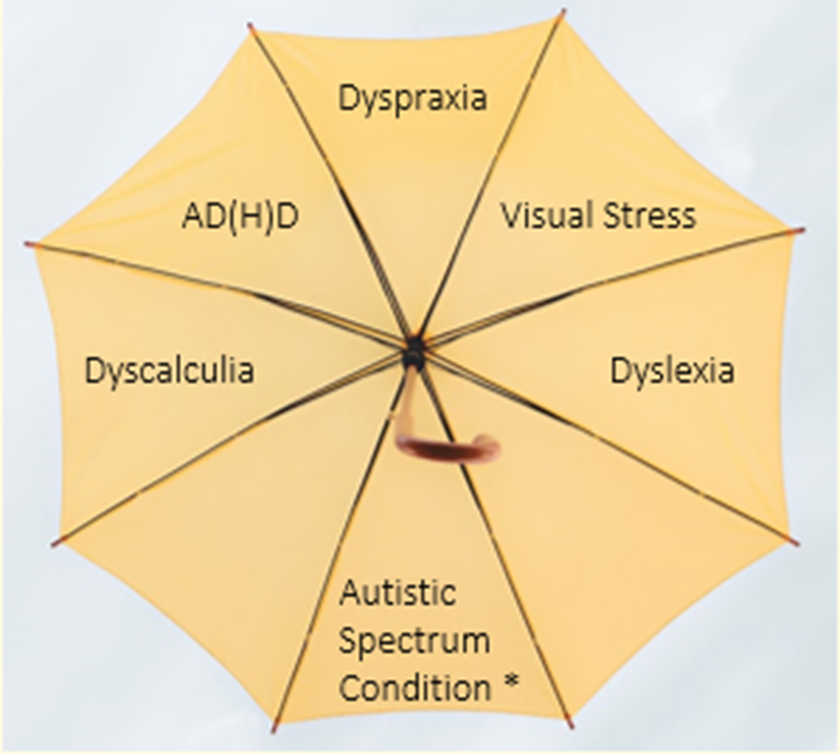
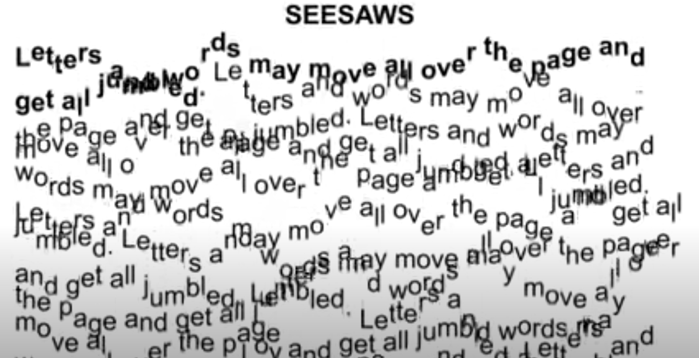
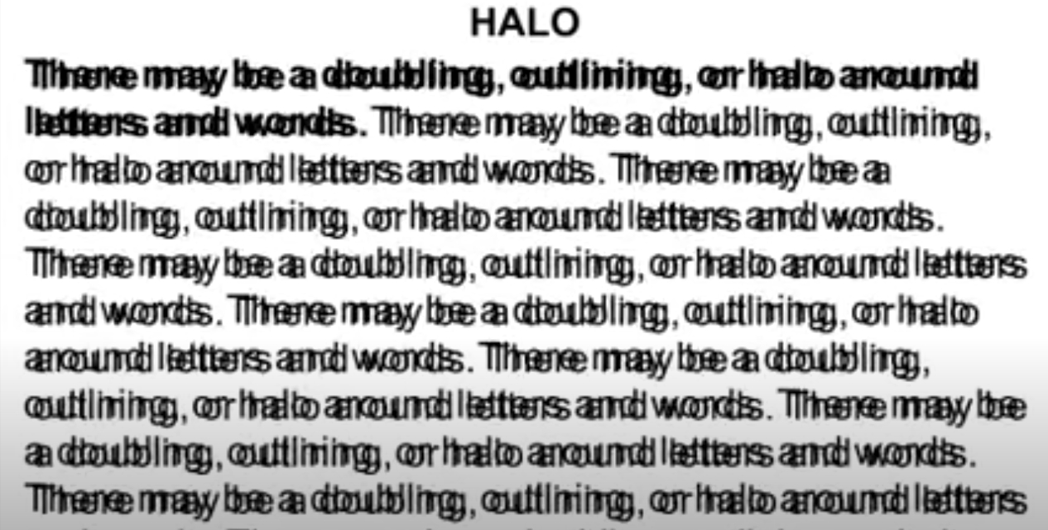
Inclusive Learning Practices – EAP students with SpLDs
Jennifer Cowell (MSc TESOL student, University of St Andrews)
1 DEFINITION
4
SIMULATIONS
6 INCLUSIVE LEARNING
Specific Learning Differences (SpLDs):
Umbrella term proposed by the UK Department for Education Working Group in 2005.
Incorporates a range of different learning disabilities due to their overlapping nature.
Equality Act 2010 – disabilities are protected characteristics and HEIs have legal obligations.
All students are individuals, and everyone experiences their SpLD(s) differently.
Whilst there are some common patterns with SpLDs, these vary in severity and significance for each individual.
Common signs of dyslexia are the same as common EFL errors so can be extremely difficult to tell them apart (Kormos, 2016). If a student is being tested for dyslexia, then it must be in their native language for this reason.
The below images are sample print distortions of what is can be like to have visual stress. For the full experience watch this video by Irlen Institute.
To experience what it might be like to have dyslexia, write the following text in 3 minutes onto a blank (non-lined) piece of paper. Hold the pen in your non-dominant hand and incorporate the following substitutions:
e = + a = ? I = -
Some people are light or colour sensitive. Bright sunlight or fluorescent lights may bother them. Black print on shiny white paper may be uncomfortable and be a problem. It may be helpful to have:
  Coloured paper for writing
  Coloured overlays for reading
  Tinted lenses in glasses for both reading and writing. The colours and brightness on computer screens can be adjusted to suit individuals
Additional support/adjustment records are reactive, rather than proactive. Some students won’t realise they have an SpLD or wish to declare it, so inclusive learning is essential in all classes, especially the EAP classroom.
For written accessibility it is best to use off-white or coloured paper, with text in a font size 12 or larger. Sans-serif fonts are best, e.g. Calibri or Arial. There is also Dyslexie which is a free specially designed font for people with dyslexia.
Digital accessibility: ensure alt text is used on images for screen readers, and provide learning materials in an open, editable format where possible i.e. not PDF or scans.
Use variety in the classroom! Peer learning, interactive sessions, and simplified word choice without ‘dumbing down’ will help. Define new terms and provide clear sign posting.
Some useful websites include: JISC digital accessibility tool kit; searchBOX: a comprehensive directory created to help source accessible content; QAA enhancing inclusion and accessibility tool kit.
Inclusive design to lessons can help all students!
Remind students that asking for help does not mean they are failing.
Some students may fidget in class and appear to be distracted e.g. doodling. This could be a coping mechanism that is helping them to concentrate! If it is not disrupting the lesson for the other students then consider permitting this behaviour.
Inclusive practices to consider as recommended by Sathy & Hogan (2019):
Silence in the classroom is OK! You can use the think-pair-share gateway technique to active learning.
Add structure to small-group discussions.
Allow anonymous participation. Low-tech solution: notecards. High-tech solutions: audience response system e.g. PollEverywhere, padlet, and mentimeter
Show you’re human. Be truthful about areas of your context that you find difficult
Connect with students personally - use their names and be approachable.
* by association, as high percentage of people with ASC also have an SpLD.
Image credit: Katherine Kromberg on Unsplash
2 UK HEI STATS
Annually 45,000 new entrants to UK HEIs report having at least one disability, SpLDs being the most common (QS, 2019). This does not include those diagnosed once HE studies have commenced.
1.5 million people in the UK have a learning disability (Public Health England, 2016 & Office for National Statistics, 2019).
Between 33% and 50% of those with dyslexia also have visual stress (British Dyslexia Association, n.d.).
1 in 10 students require additional support provisions including for SpLDs (Office for Students, 2019).
3 CULTURES
Dyslexia simulation source: 'Dyslexia and Foreign Language Teaching' by Lancaster University. Available on FutureLearn
5 TRANSITIONING
There are 195 countries in the world, each with its own culture. Cultural views on SpLDs are complex, with influences from different factors including: general awareness, government policies, teacher training, historical influences, teacher training, availability of assessments and interventions (Mather, White & Youman, 2020). Unfortunately, some cultures stigmatise SpLDs and this can dissuade students from seeking diagnosis or assistance at a UK university. Inclusive learning can help.
University education can be a new and unfamiliar experience for students, and those from an international background may need support in transitioning (Bond, 2018). It is important to use a range of inclusive learning techniques to ensure students are scaffolded and have a variety of mediums to work with (Leask & Carroll, 2013). It is essential to respect and adjust for diversity (ibid) in any general learning setting, especially an EFL one. Being mindful of SpLDs students is no different and the techniques that can help them transition can be just as effective for students without SpLDs.
Top tip: be aware of cultural differences, students’ personal preferences, and support them through a scaffolded approach being mindful of how their SpLDs may affect their approaches to learning.
7 REFERENCES
Bond, B. (2018) ‘The long read: Inclusive teaching and learning for International students’, Leeds Institute for Teaching
Excellence. https://teachingexcellence.leeds.ac.uk/the-long-read-inclusive-teaching-and-learning-for-international-
students/
House of Commons Library, UK Parliament. (2020). Research Briefing: International and EU students in higher education in
the UK FAQs. Retrieved from https://commonslibrary.parliament.uk/research-briefings/cbp
-7976/#:~:text=In%202018%2F19%20there%20were,EU%20and%20343%2C000%20from%20elsewhere.
Kormos, J. (2016). The Second Language Learning Processes of Students with Specific Learning Difficulties. New York:
Routledge.
Leask, B., and Carroll, J. (2013) Learning and Teaching Across Cultures. Good Practice Principles and Quick Guides.
Melbourne: International Education Association of Australia.
Mather, N., White, J., and Youman, M. (2020) ‘Dyslexia Around the World: A Snapshot’, Learning Disabilities: A
Multidisciplinary Journal, 25 (1), pp. 1-17.
Office for Students. (2019). Insight brief: Beyond the bare minimum: Are universities and colleges doing enough for disabled
students?. Retrieved from https://www.officeforstudents.org.uk/publications/beyond-the-bare-minimum-are-universities-
and-colleges-doing-enough-for-disabled-students/.
QS Quacquarelli Symonds. (2019). What Support Should Universities Provide to Students with Specific Learning Difficulties?.
Retrieved from https://www.qs.com/what-support-should-universities-provide-students-specific-learning-difficulties/.
Sathy, V., and Hogan, K. A. (2019) ‘How to Make Your Teaching More Inclusive’, The Chronicles of Higher Education.
Retrieved from: https://www.chronicle.com/interactives/20190719_inclusive_teaching#2
The University of St Andrews is a charity registered in Scotland, No: SC013532

