Slide 1
Rethinking Assessment: some reflections
Guglielmo Volpe
Department of Economics | City, University of London

Slide 2
Broad plan
Grappling with assessment in COVID time
The City experience
My own experience + some examples from the sector
Perhaps less reliance on exams?
  Employability
  Authentic Assessment
  NSS2023

Slide 3


Spring 2020
  Technical issues
    Length of exam: 24 hour vs time-limited exam
    Time Zones
    Upload time
    IT infrastructure
  Pedagogical issues
    Assessment design
    Robustness of assessment

Slide 4

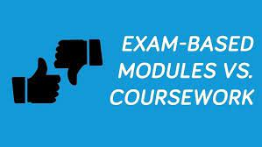
2020/2021/2022 and looking ahead
  Online Exams / Return to on-campus exams
    Length of exam: 24 hour vs time-limited exam
    IT infrastructure
    Logistics/Capacity
Pedagogical Issues
  Assessment Design
  Robustness
  Applicability of coursework-type assessment to some fields
  Alternative assessment
    Project/Essay/Case Study
    Video/Oral presentations
    General move towards removing/reducing exams

Slide 5
The City Experience
University / School decision to diversify assessment
Removal of most exams from UG economics curriculum
Issues
  “Defensive” reaction by academic staff
  Issues with length of assessment
  Difficulty / Challenges in assessment design
  Logistics of assessment timetable
  Students ‘adjustment’ to new assessment
Outcome
  Distributions in line with previous years
  Students (final year in particular) more prone to challenge marks
  Anecdotal evidence about students’ learning
  Colleagues would not necessarily go back to exams for all modules

Slide 6
Personal experience
Data Analysis 2
Coursework 1
Group project
  Portfolio with tasks driven by real world data
  Submission at end of term
  50% of overall mark
Coursework 2
  Individual Project
  Research project/report (gender pay gap)
  50% of overall mark
Overall experience
  Positive performance in 2021 but weaker in 2022
  No evidence of collusion or ‘cheating’

Slide 7
Personal experience
Intermediate Macroeconomics 1
Coursework 1
  Group project
  Written report on macroeconomic analysis of a given country
  Submission at end of term
  50% of overall mark
Coursework 2
  Individual coursework
  Set Exercises
  Coursework to be completed in 48 hours
  50% of overall mark
Overall experience
  Good group projects
  Mixed quality of individual projects
  Some evidence of collusion/collaboration in individual coursework

Slide 8
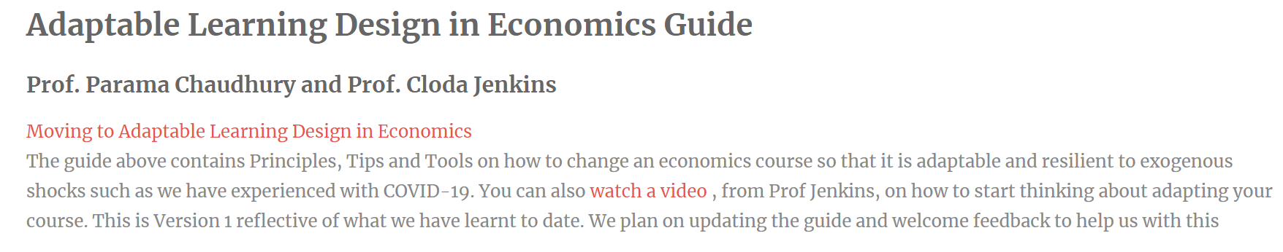
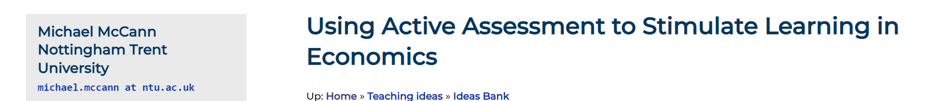
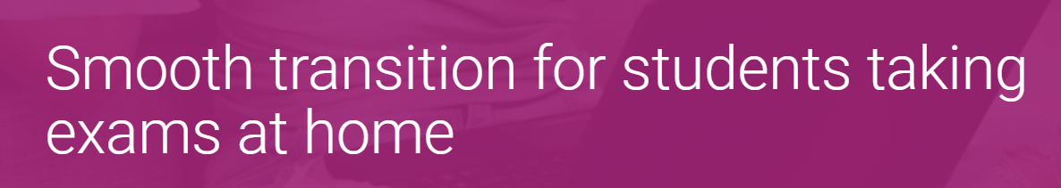
Examples of coursework-based assessment

Slide 9

What do we take away from the pandemic experience?
Are we overly worried about academic misconduct?
Return to normality?
Change is here to stay
It is possible to assess differently
Bloom taxonomy
Can students handle the change?
But change is difficult and costly
Learning outcomes
Class size / Resources

Slide 10
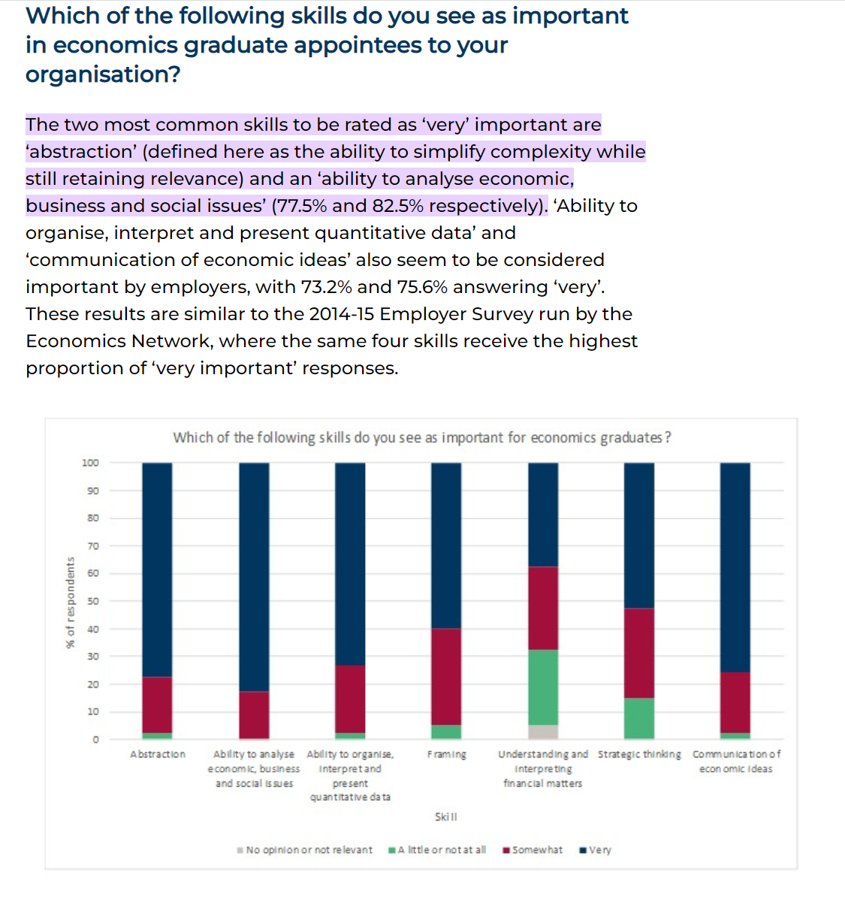
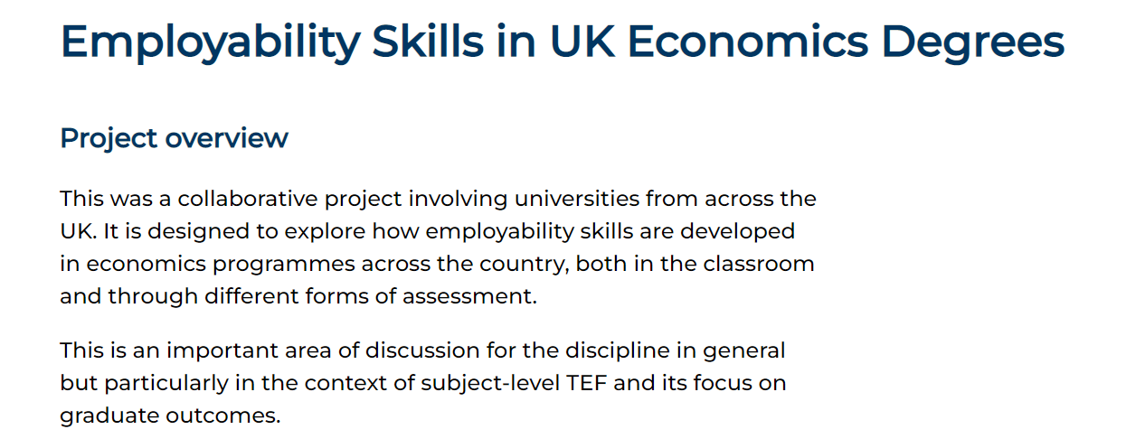
Why should we reflect on assessment?
What are employers looking for?

Slide 11
Why should we reflect on assessment? – Authentic Assessment
An authentic assignment is one that requires application of what students have learned to a new situation, and that demands judgment to determine what information and skills are relevant and how they should be used. An assignment is authentic if it
  is realistic
  requires judgment and innovation
  asks the student to “do” the subject
  replicates or simulates the contexts in which adults are “tested” in the workplace or in civic or personal life.
  assesses the student’s ability to efficiently and effectively use a repertoire of knowledge and skills to negotiate a complex task
  allows appropriate opportunities to rehearse, practice, consult resources, and get feedback on and refine performances and products

Slide 12

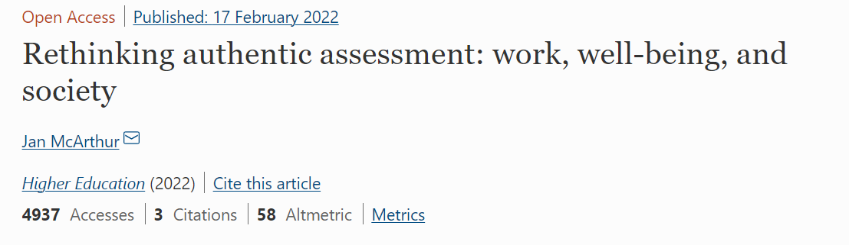
Rethinking Assessment: Authentic Assessment

Slide 13
NSS2023 and Rethinking Assessment?

Slide 14
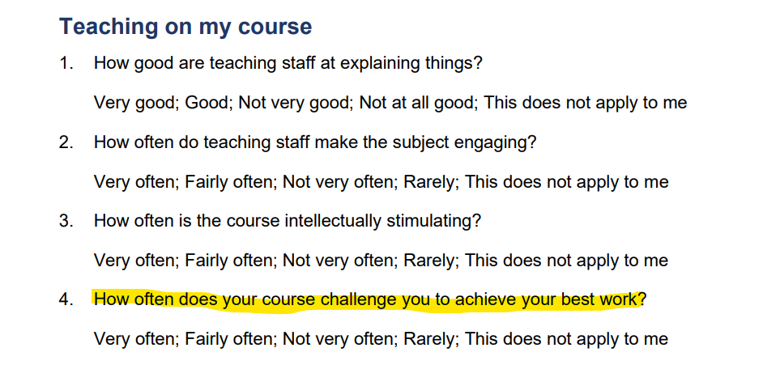
Perhaps the 2023NSS can provide a nudge
https://www.officeforstudents.org.uk/publications/national-student-survey-2023/

Slide 15
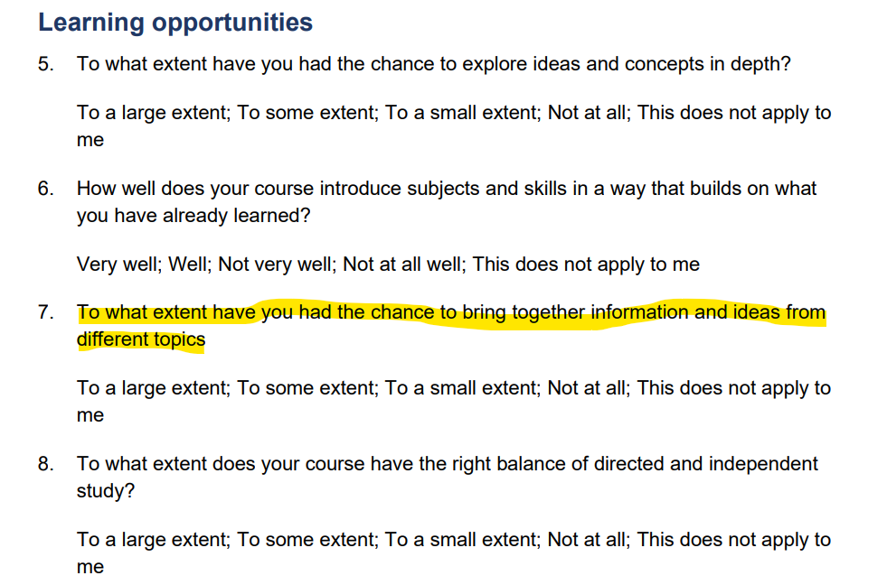
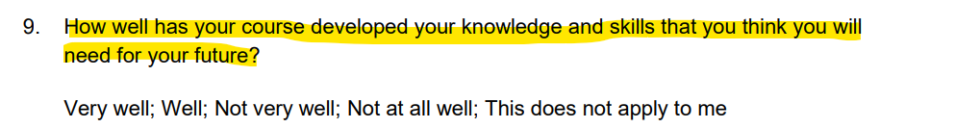
Perhaps the 2023NSS can provide a nudge

Slide 16
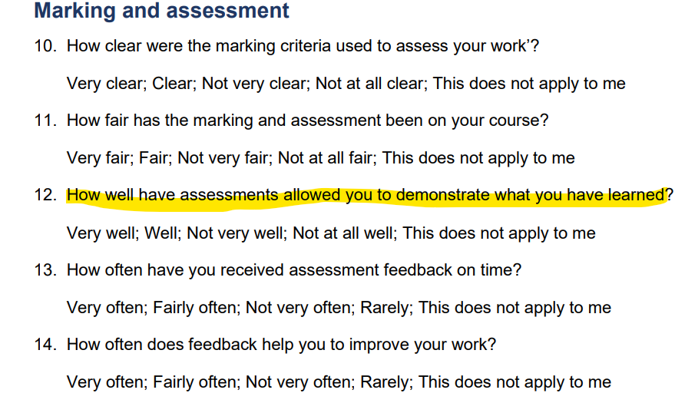
Perhaps the 2023NSS can provide a nudge

Slide 17
Summary
Historically, exams have been over-represented in economics assessment
The pandemic has shown that it is possible to reduce the reliance on exams
The worry about cheating is, perhaps, over-estimated
It is possible to design robust and authentic assessment
It is not an easy process and requires careful considerations (also with respect to students’ engagement with such assessment)
However, it is likely to improve the students’ experience and their readiness for the labour market or further studies

